Slide 1
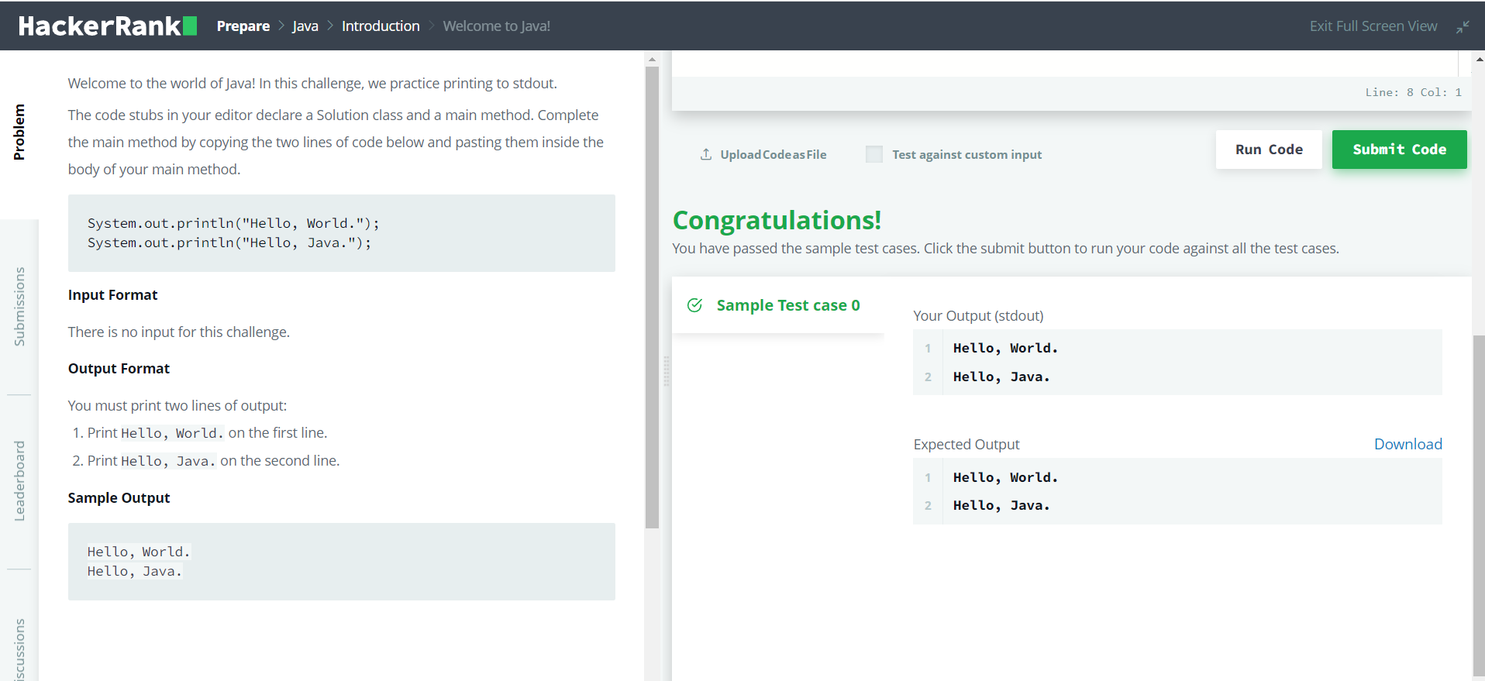
Day 1 of 100dayscodechallenge Platform – Hacker Rank Problem Statement 1 for Java :

Slide 2
Solutions for problem 1:
public class Solution {
public static void main(String[] args) {
System.out.println("Hello, World.");
System.out.println("Hello, Java.");
}
}
Explained-
Used the basic syntax to print hello, World and Hello ,Java.

Slide 3
Output for 1-

Slide 4
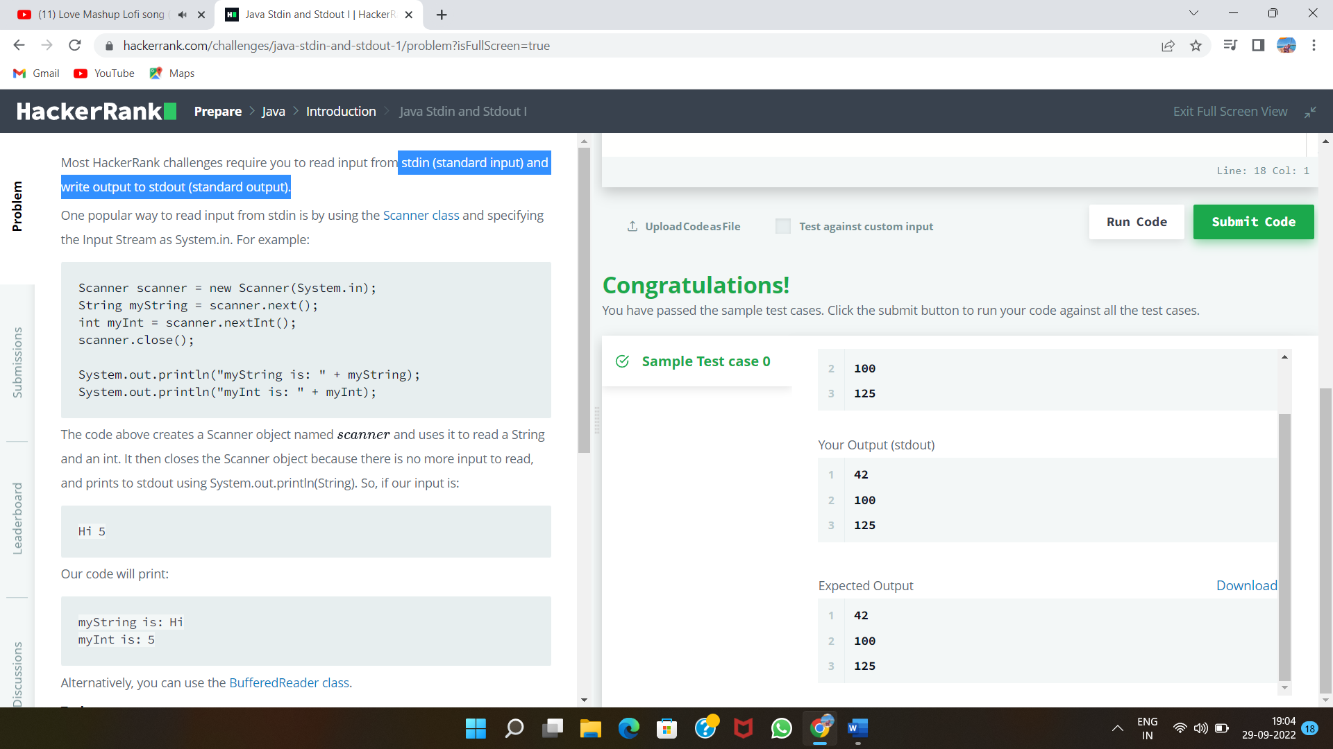
Problem 2 from hackerRank-

Slide 5
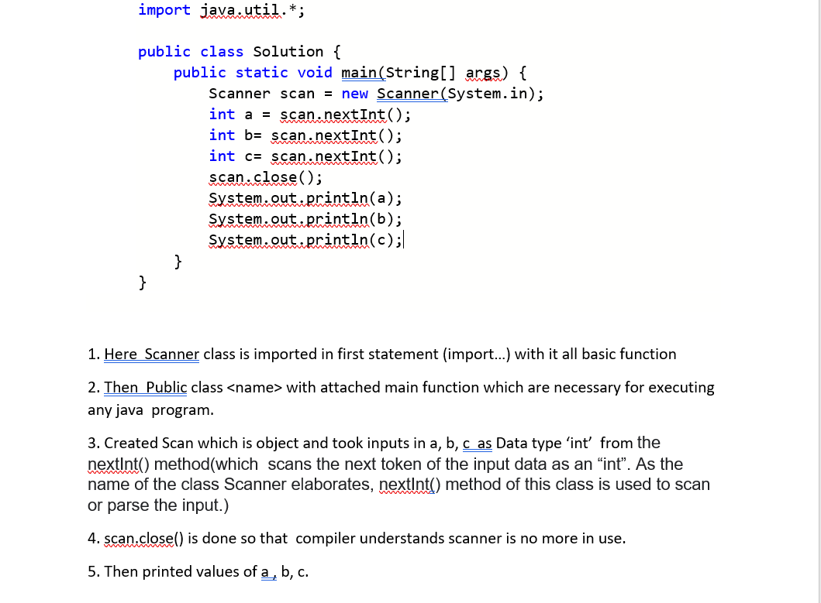
Solutions for problem 2 with Explanation:

Slide 6
Output for 2-

Slide 7
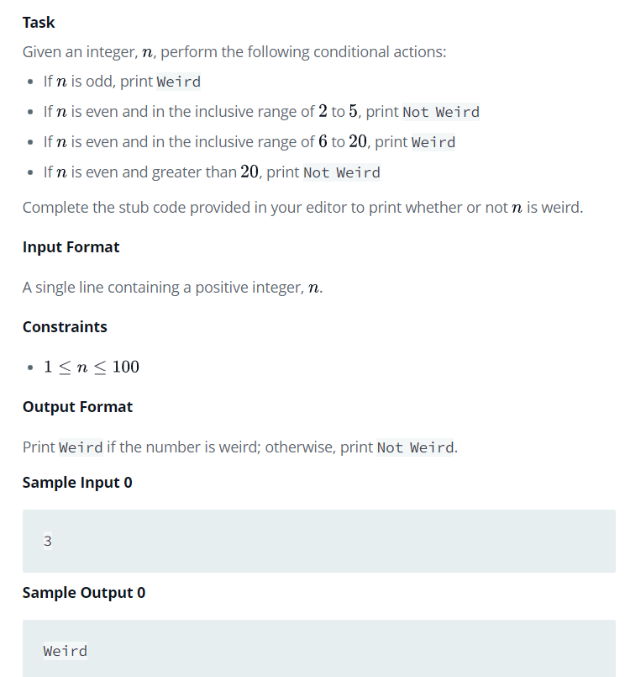
Problem 3 from hackerRank-

Slide 8
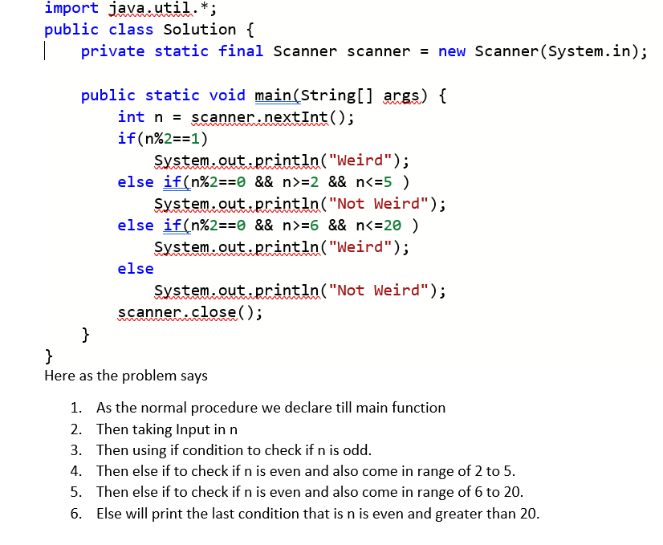
Solutions for problem 3 with Explanation:

Slide 9
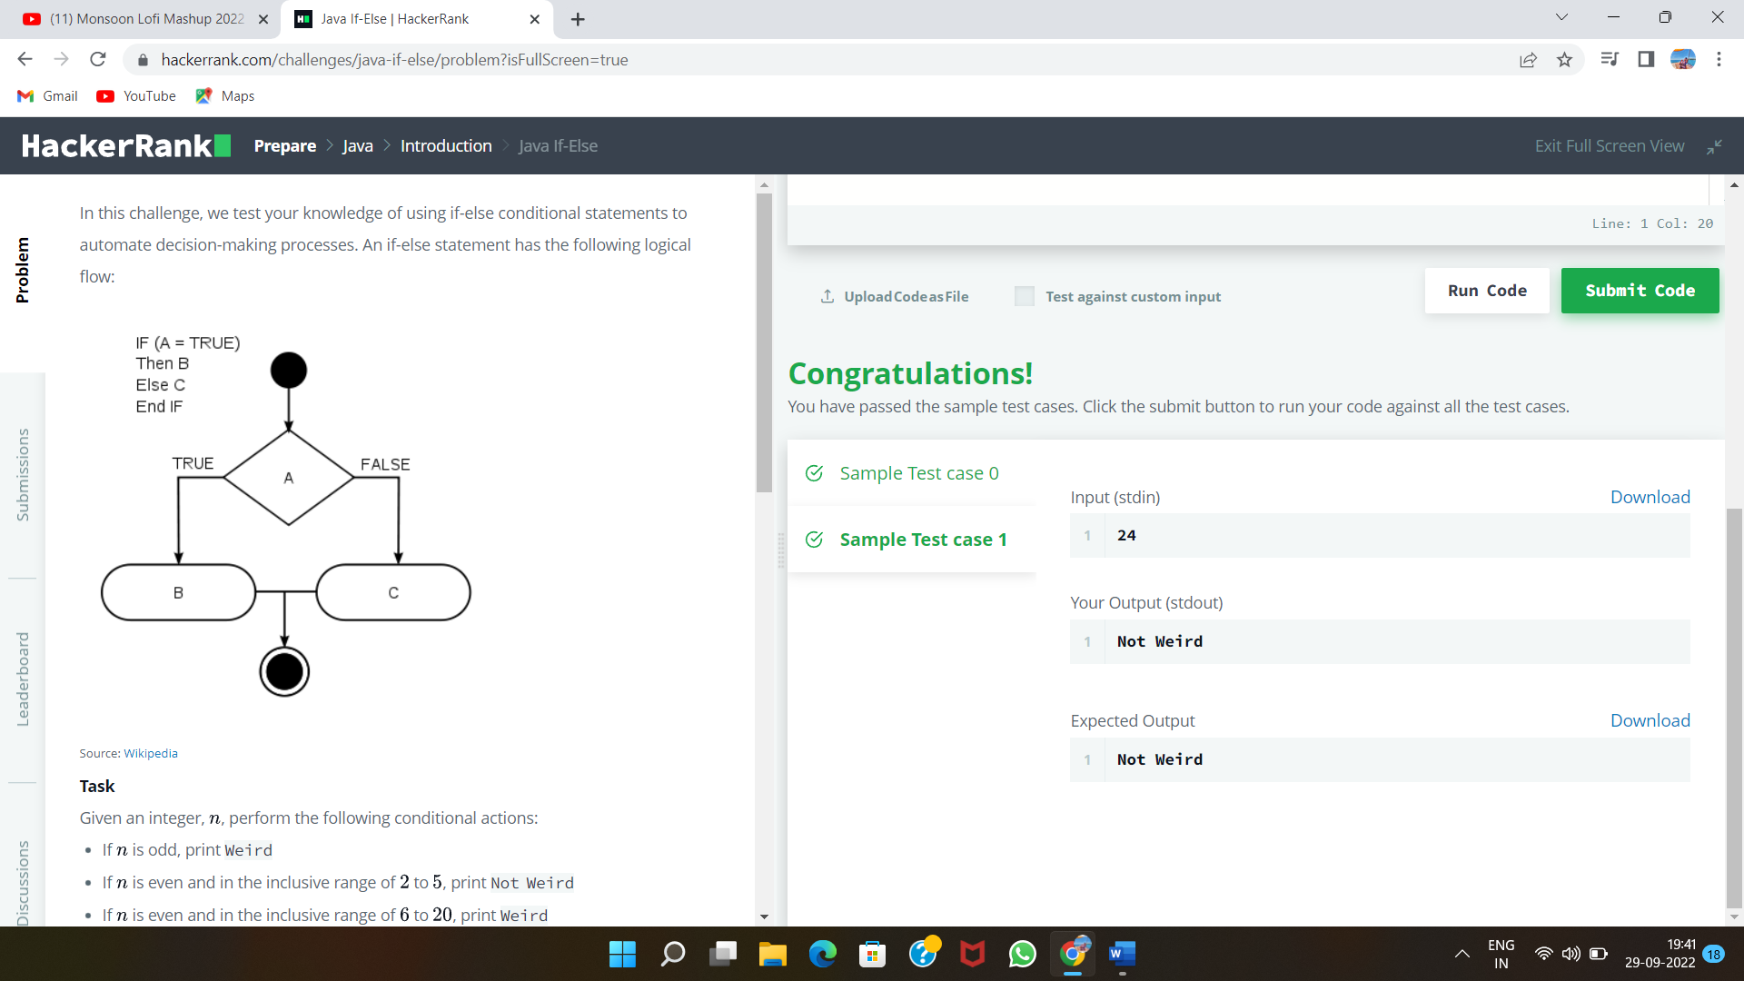
Output for 3-

Slide 10
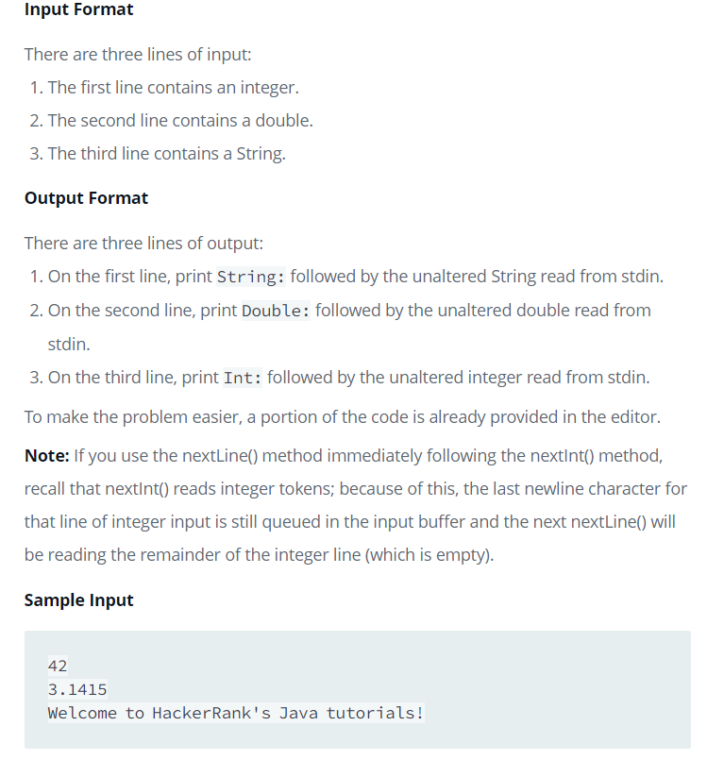
Problem 4 from HackerRank-

Slide 11
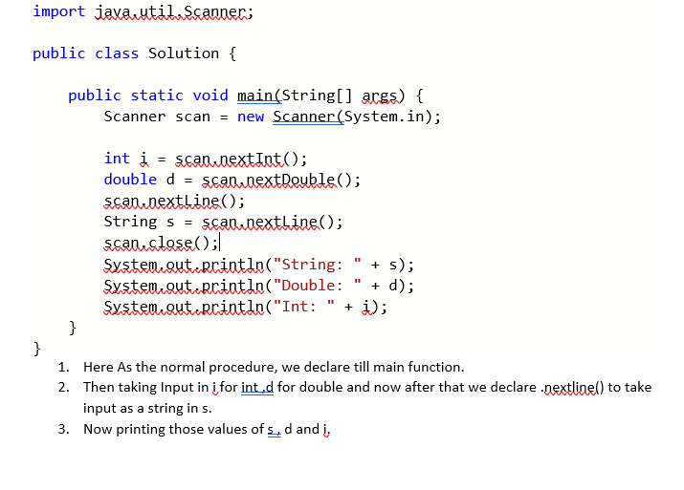
Solutions for problem 4 with Explanation:

Slide 12
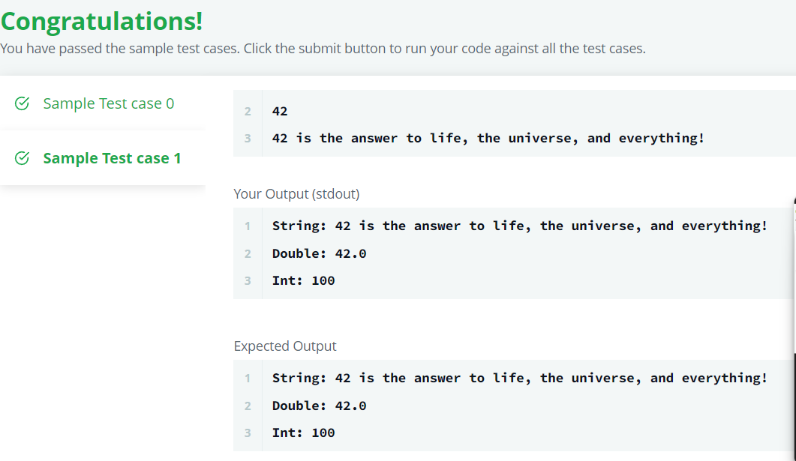
Output 4-

Slide 13
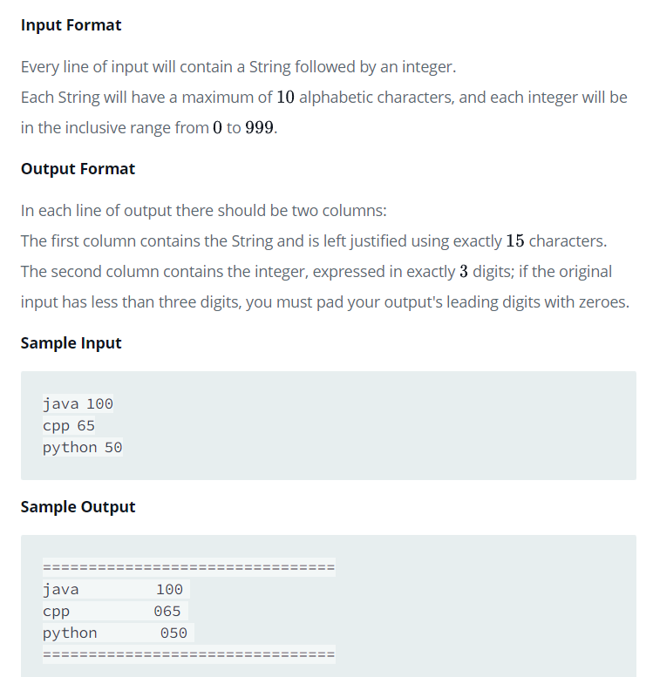
Problem 5 from HackerRank-

Slide 14
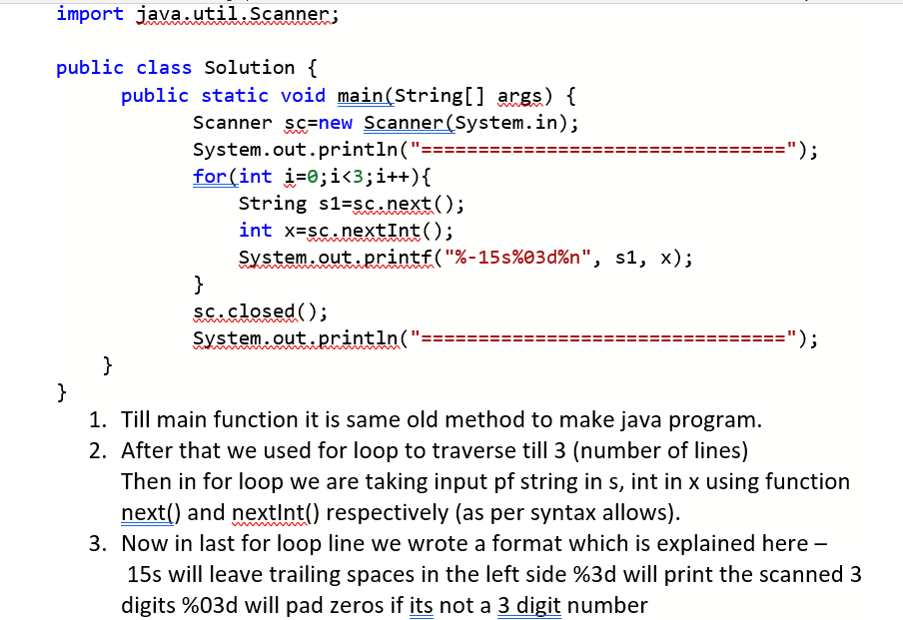
Solutions for problem 5 with Explanation:

Slide 15
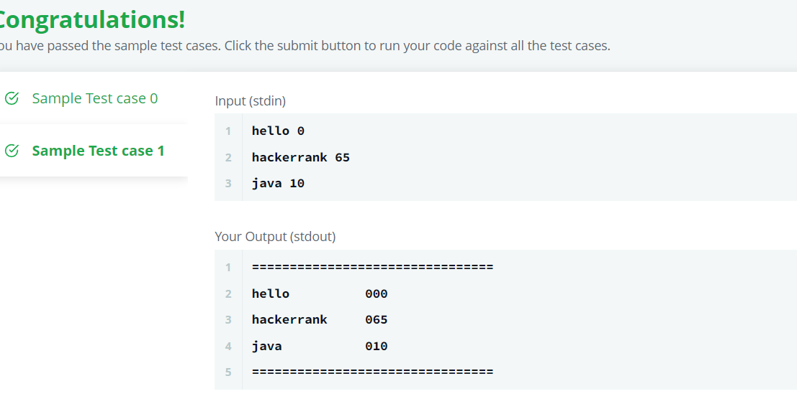
Output 5-

Slide 16
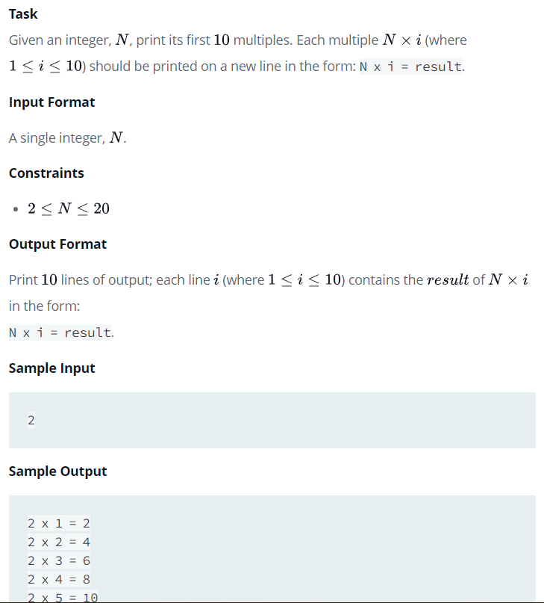
Problem 6 from HackerRank-

Slide 17
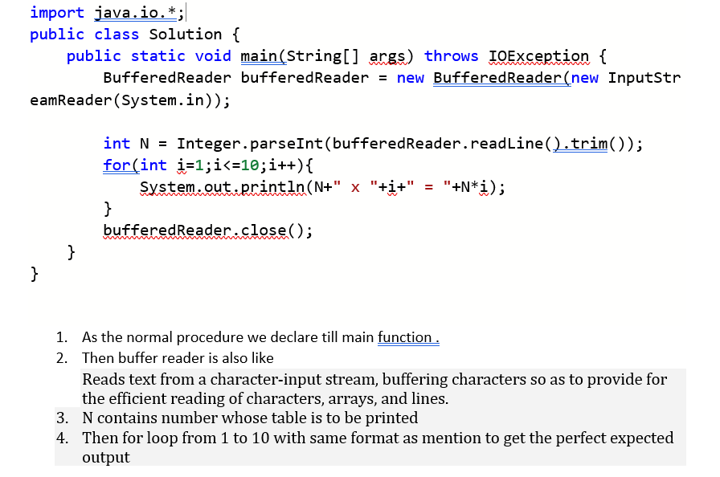
Solutions for problem 6 with Explanation:

Slide 18
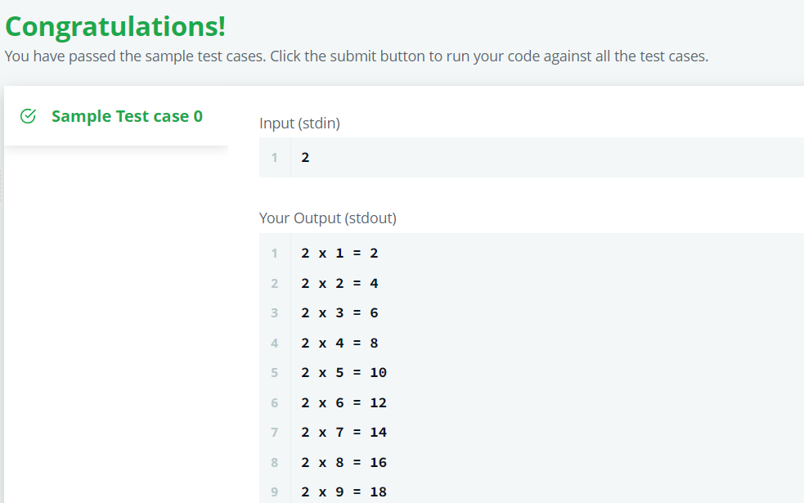
Output 6-

